Slide 1
Financial manager
Course Project for CSCI 352
Lucian Freeze/Brett Whitson

Slide 2
Overview
Background
Approach
Diagrams
Demo
Future Work
Questions

Slide 3
Background
This project is an application that students can use to keep track of and control their spending with an easy-to-use streamlined interface.
We decided on this because we as low-income college students could use this kind of application in every day life.

Slide 4
Approach
We utilized the relational database tools in Microsoft Access to store user account data and SQL to query the database from our C# code.
Additional driver needed for database functionality, available at:
https://www.microsoft.com/en-us/download/confirmation.aspx?id=23734
One design pattern we used was the Abstract Factory pattern to create theming within the application.

Slide 5
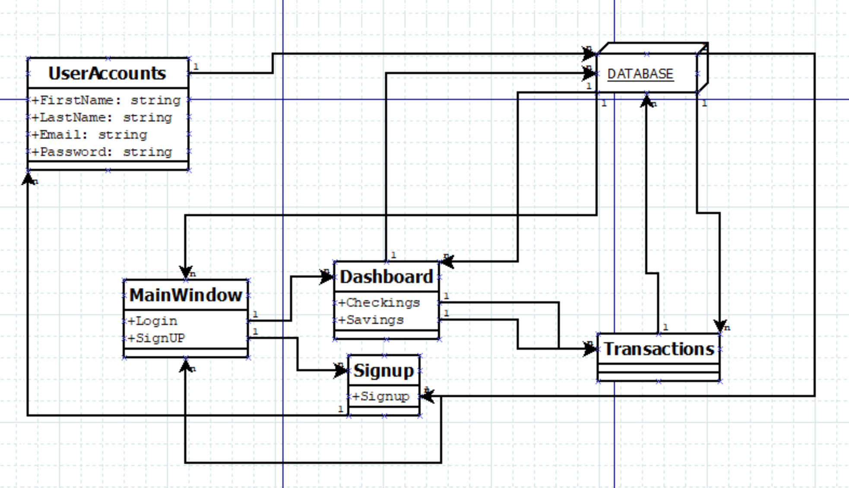
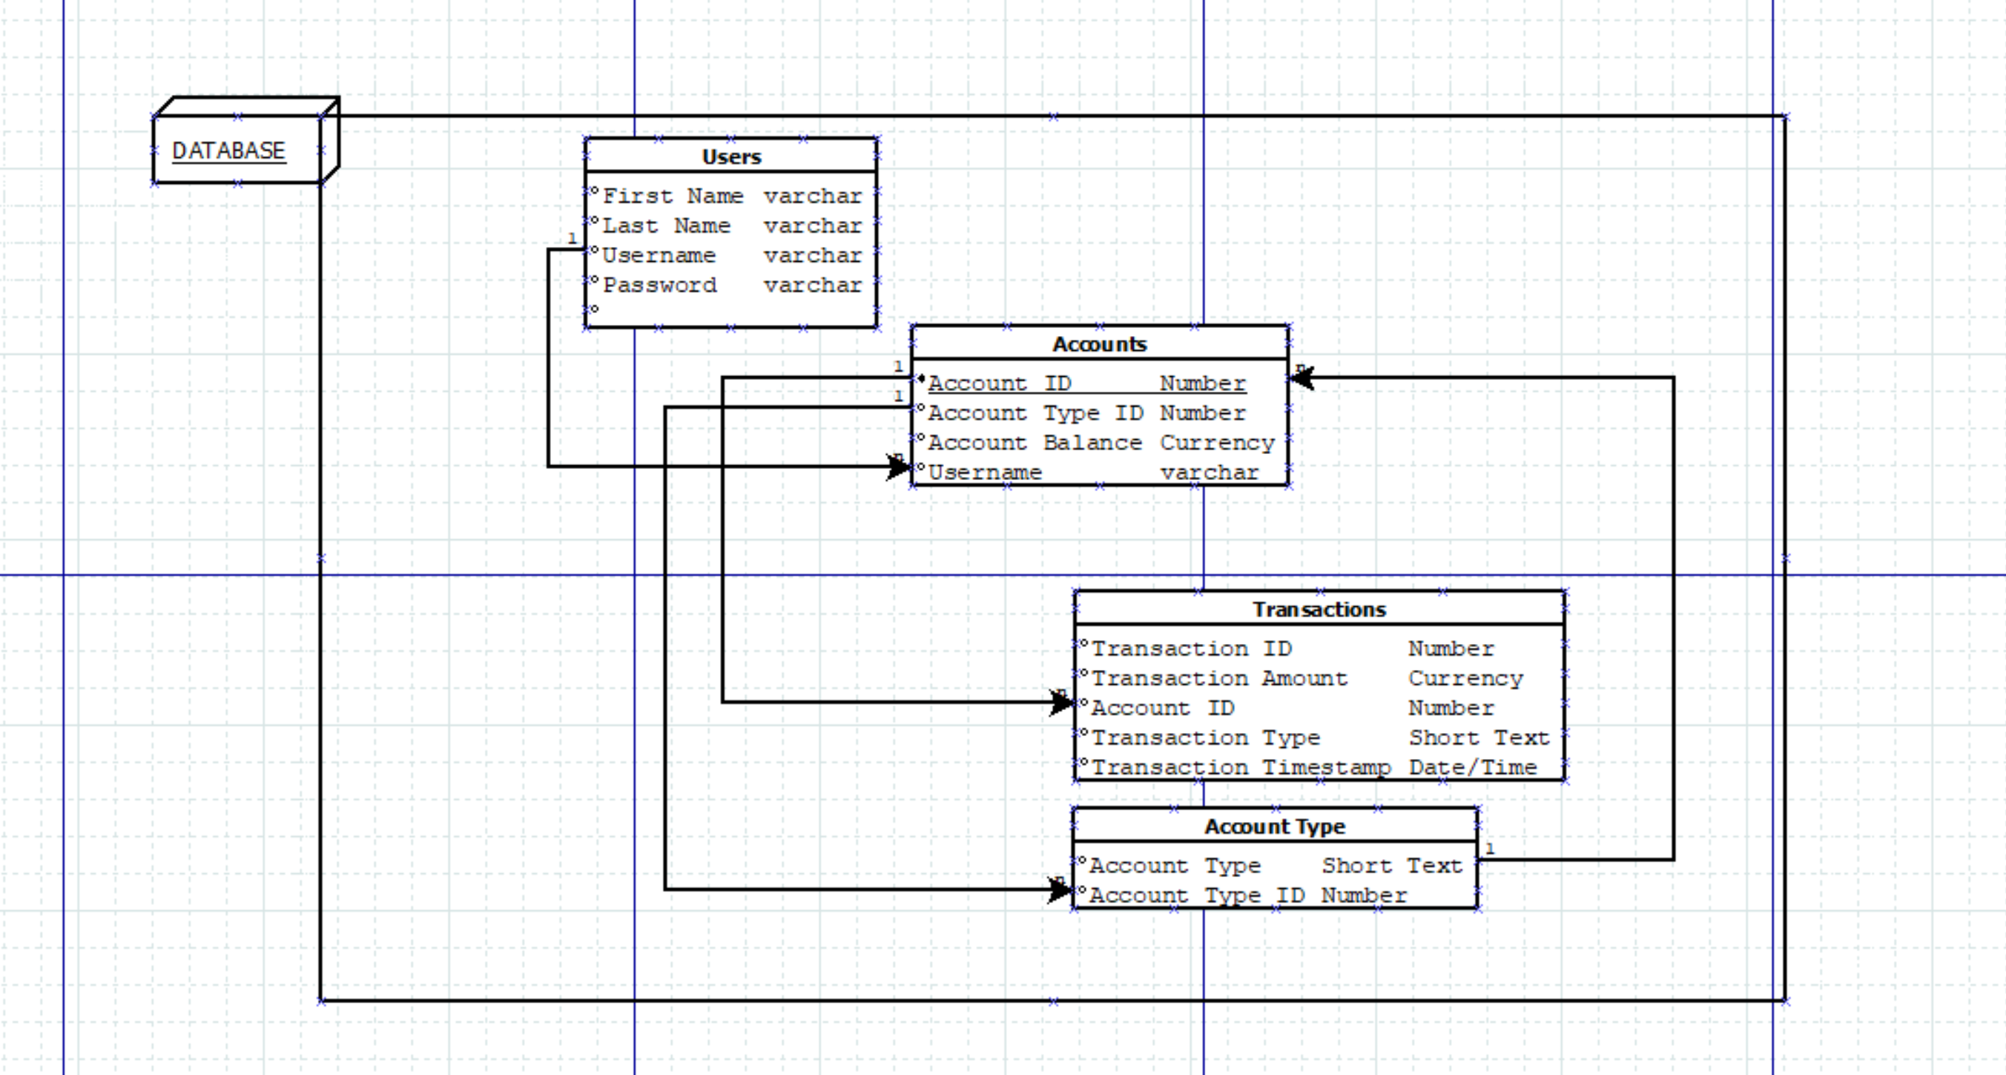
Diagrams
Database Structure
Program Structure

Slide 6
using system.info.demo static void main() { Demo projectDemo = new Demo(); projectDemo.make_good(); projectDemo.begin(); }

Slide 7
Future work
In the future we hope to expand on everything we have achieved already as well as implement real bank APIs and if possible, add a new investment section.

Slide 8
Questions
lfreeze@utm.edu
bremwhit@ut.utm.edu
The Repo:
https://github.com/lucianfreeze/CSCI352-Project-Freeze-Whitson

